Slide 1
Preparing Poster Presentation
Dr. Nisreen AL-Quraan
Dept. Biotechnology and Genetic Engineering
Jordan University of science and Technology

Slide 2
Poster…why?
Effectively share research results and engage in scientific dialog with colleagues
Feedback received help in refining your research and preparing it for publication

Slide 3
Planning the Poster Presentation
Review the instructions and specific requirements for the conference or event where you will present
Audience
Budget
Keep the message simple
Obtain feedback from mentors and advisor

Slide 4
Organizing the content
How to set up your poster:
  Columns should flow left to right
  Use headings and subheadings
  Use arrows or numbers to direct flow where necessary
  Use white background
  Use color …be reasonable!

Slide 5
Components for Research Poster
Title
  Make it simple but attractive to the readers
  Include authors below the title
  Affiliations of the authors
Abstract….briefly!
  Summarize the research project
  Include the study’s objective(s), design, results and conclusion(s)

Slide 6
Components for Research Poster
Introduction
  Rationale and importance of study
  Hypothesis or research question that was tested
Methods
  Sufficient information to judge the validity of the study
  Sample size, study design, data collection and analytic methods, outcome and exposure measures

Slide 7
Components for Research Poster
Results
  Key findings using mainly tables and figures
  Keep the results as simple as possible
Conclusion
  Interpret your results in the context of your study as well as the literature
  Provide readers with what is new from your study

Slide 8
Technical considerations
Poster should be easily seen from at least 3 feet
Use fonts that are easy to read and use no more than two fonts !!
  Headings → Arial
  Text → Times
Keep the color scheme simple and consistent throughout the poster!!

Slide 9
PowerPoint Specifics for Single Sheet Posters
Maximum dimension 150 cm
Up to 150 cm wide
  Create actual size
  Text 24 point
Up to 100 cm length
  Create actual size
  Text 24 point

Slide 10
Printing Considerations
Leave a white border (for push-pins)
Remember to spell check
Check every cm and check again….. Again!!!
Ask a colleague/mentor to look and proof the poster

Slide 11
Practical Tips for Posters
Keep it Simple
Remember to Spell Check
Don’t use ALL CAPITALS
Bold is used for emphasis
Italics de-emphasize
Use active verbs
Use color….reasonable!

Slide 12
Pre-Poster Presentation Tips
Arrive early at the poster display site
Hang poster neatly
You might:
Prepare miniature versions of the poster to handout …..paper sheets…abstract….sketch…etc.

Slide 13
Presenting the Poster
Use the poster as a visual aid
  Refrain from reading it
Use the graphics to support your points when telling your story
Prepare a 2 and 5 minute tour of the poster

Slide 14
Poster Templates

Slide 15
Poster title goes here, containing strictly
only the essential number of words...
Author’s Name/s Goes Here, Author’s Name/s Goes Here, Author’s Name/s Goes Here
Address/es Goes Here, Address/es Goes Here, Address/es Goes Here
Introduction
Method
Results
First…
Check with conference organisers on their specifications of size and orientation, before you start your poster eg. maximum poster size; landscape, portrait or square.
The page size of this poster template is A0 (84x119cm), landscape (horizontal) format. Do not change this page size, MIU can scale-to-fit a smaller or larger size, when printing. If you need a different shape start with either a portrait (vertical) or a square poster template.
Bear in mind you do not need to fill up the whole space allocated by some conference organisers (eg. 8ftx4ft in the USA). Do not make your poster bigger than necessary just to fill that given size.
Tips for making a successful poster…
Re-write your paper into poster format ie.
Simplify everything, avoid data overkill.
Headings of more than 6 words should be in upper and lower case, not all capitals.
Never do whole sentences in capitals or underline to stress your point, use bold characters instead.
When laying out your poster leave breathing space around you text. Don’t overcrowd your poster.
Try using photographs or coloured graphs. Avoid long numerical tables.
Spell check and get someone else to proof-read.
Importing / inserting files…
Images such as photographs, graphs, diagrams, logos, etc, can be added to the poster.
To insert scanned images into your poster, go through the menus as follows: Insert / Picture / From File… then find the file on your computer, select it, and press OK.
The best type of image files to insert are JPEG or TIFF, JPEG is the preferred format.
Be aware of the image size you are importing. The average colour photo (13 x 18cm at 180dpi) would be about 3Mb (1Mb for B/W greyscale). Call MIU if unsure.
Do not use images from the web.
Notes about graphs…
For simple graphs use MS Excel, or do the graph directly in PowerPoint.
Graphs done in a scientific graphing programs (eg. Sigma Plot, Prism, SPSS, Statistica) should be saved as JPEG or TIFF if possible. For more information see MIU.
Printing and Laminating…
Once you have completed your poster, bring it down to MIU for printing. We will produce a A3 size draft print for you to check and proof read. The final poster will then be printed and laminated.
Note: Do not leave your poster until the last minute. Allow at least 5 working days before you need to use it.
Simply highlight this text and replace.
Cost…
For poster-printing and laminating charges contact to MIU
Captions to be set in Times or Times New Roman or equivalent, italic, between 18 and 24 points.
Left aligned if it refers to a figure on its left. Caption starts right at the top edge of the picture (graph or photo).
Conclusion
Aim
For more information on:
Poster Design, Scanning and Digital Photography,
and Image / file size.
Contact:
Medical Illustration Unit
Prince of Wales Hospital
Ph: 9382 2800
Email: miunsw@unsw.edu.au
Web: http://miu.med.unsw.edu.au
How to use this poster template…
Simply highlight this text and replace it by typing in your own text, or copy and paste your text from a MS Word document or a PowerPoint slide presentation.
The sub-title text boxes can be moved up or down depending on how big or small your ‘Introduction’, ‘Aim’, ‘Method’, ‘Results’ and ‘Conclusion’ are.
The body text / font size should be between 24 and 32 points. Arial, Helvetica or equivalent.
Keep body text left-aligned, do not justify text.
The colour of the text, title and poster background can be changed to the colour of your choice.
Captions to be set in Times or Times New Roman or equivalent, italic, between 18 and 24 points. Right aligned if it refers to a figure on its right. Caption starts right at the top edge of the picture (graph or photo).
Captions to be set in Times or Times New Roman or equivalent, italic, between 18 and 24 points.
Left aligned if it refers to a figure on its left. Caption starts right at the top edge of the picture (graph or photo).
Acknowledgements
Just highlight this text and replace with your own text. Replace this with your text.
Captions to be set in Times or Times New Roman or equivalent, italic, 18 to 24 points, to the length of the column in case a figure takes more than 2/3 of column width.
Captions to be set in Times or Times New Roman or equivalent, italic, 18 to 24 points, to the length of the column in case a figure takes more than 2/3 of column width.

Slide 16
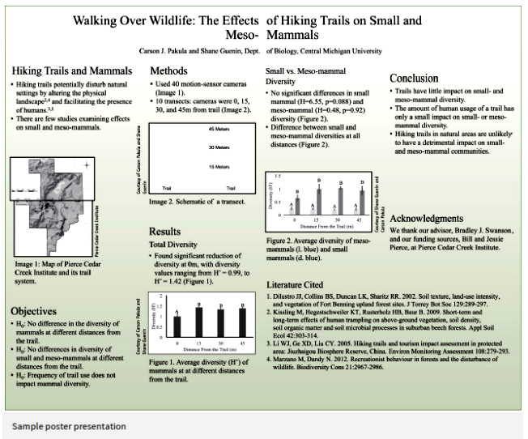

Slide 17


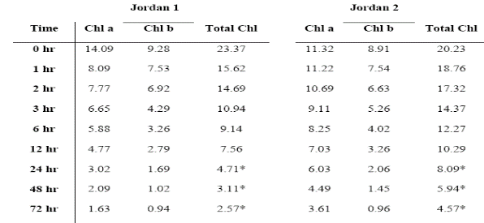
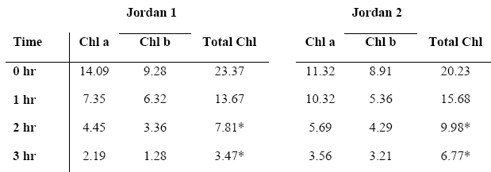
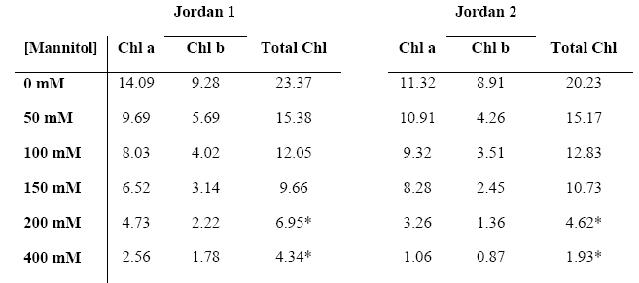
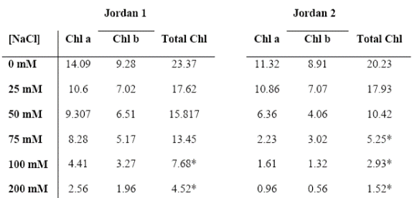
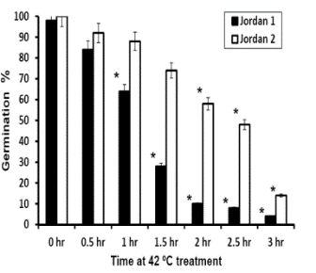
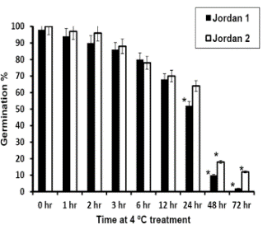
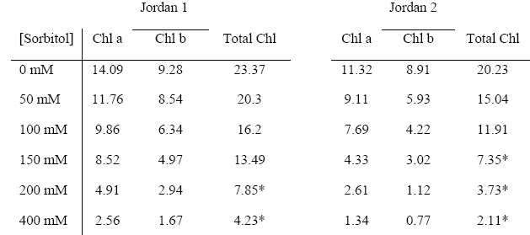
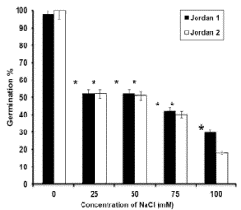
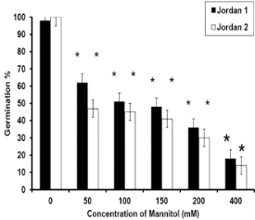
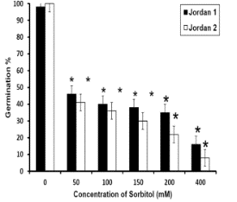
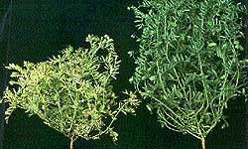
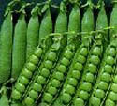
Effect of temperature, salt and osmotic stresses on seed germination and chlorophyll contents in Lentil (Lens culinaris Medik)
P095
Nisreen A. AL-Quraan, Morad Al-Sharbati, Yazen Dababneh, and Mahmood Al-Olabi
Department of Biotechnology and Genetic Engineering, Faculty of Science and Arts,
Jordan University of Science and Technology, Irbid 22110, JORDAN.
Introduction:
Research is needed to critically define the effects of heat, cold, salt and osmotic stress on the reproductive stages, growth and physiological activities of lentil. Prolonged exposure to high or low temperature, salinity and osmotic stress can result in retardation of growth, reduction in yield, and even death of the plants. It is therefore of great importance not only to characterize and quantitate whole plant stress phenomena, but also to investigate and critically evaluate the molecular consequences of abiotic stresses changes.
The objectives of this study is to determine the effect of cold and heat treatments, salinity and osmotic stress using sodium chloride, Mannitol, and Sorbitol on the seed germination and seedling chlorophyll a and b content in 2-week-old lentil plants (Lens culinaris Medik) seedlings.
Table 1: Effect of different cold treatments (4 ºC) on total chlorophyll (Chl.a and Chl.b) contents (mg/g FW) of lentil (Lens culinaris Medik) two cultivars, Jordan 1 and Jordan 2. Each value is a mean of three replicates. Treatments with (*) represent the significance level at P < 0.05.
Table 2: Effect of different heat treatments (42 ºC) on total chlorophyll (Chl.a and Chl.b) contents (mg/g FW) of lentil (Lens culinaris Medik) two cultivars, Jordan 1 and Jordan 2. Each value is a mean of three replicates. Treatments with (*) represent the significance level at P < 0.05.
Materials and Methods:
Two Jordan cultivated lentil (Lens culinaris Medik) cultivars, Jordan 1 and 2, were tested for their tolerance to cold (4ºC), heat (42ºC),salt (25,50,100, and150 mM NaCl) and osmotic stress (50,100,150,200 and 400 mM mannitol and sorbitol) in terms of seeds germination, and seedlings chlorophyll content.
Table 4: Effect of different mannitol concentration (mM) on total chlorophyll (Chl.a and Chl.b) contents (mg/g FW) of lentil (Lens culinaris Medik) two cultivars, Jordan 1 and Jordan 2. Each value is a mean of three replicates. Treatments with (*) represent the significance level at P < 0.05.
Table 3: Effect of different NaCl concentration (mM) on total chlorophyll (Chl.a and Chl.b) contents (mg/g FW) of lentil (Lens culinaris Medik) two cultivars, Jordan 1 and Jordan 2. Each value is a mean of three replicates. Treatments with (*) represent the significance level at P < 0.05
Table 5: Effect of different sorbitol concentration (mM) on total chlorophyll (Chl.a and Chl.b) contents (mg/g FW) of lentil (Lens culinaris Medik) two cultivars, Jordan 1 and Jordan 2. Each value is a mean of three replicates. Treatments with (*) represent the significance level at P < 0.05.
Results:
Jordan 2 seeds germination was reduced under cold stress but it was tolerant to heat treatment; germination reduced up to 50-80%.
Germination % under various NaCl, mannitol and sorbitol concentrations decreased and delayed in both cultivars after 7 days of treatment.
Jordan 2 cultivar showed lower inhibition in chlorophyll synthesis under cold and heat stress than Jordan 1 cultivar.
Heat stress inhibited chlorophyll synthesis in both cultivars.
The chla and chl b contents of both cultivars decreased as NaCl concentration increased.
Mannitol treatments caused higher reduction in chlorophyll contents in Jordan 2 than Jordan 1 seedling.
Total chlorophyll contents for both cultivars reduced under all sorbitol treatments.
Figure 1: seeds germination of lentil (Lens culinaris Medik) cultivars, Jordan 1 and Jordan 2, under cold and heat treatments.
Conclusion:
The results showed direct effects of cold, heat, salt and osmotic abiotic stresses on seed viability and photosynthetic pigments in both Jordan lentil cultivars. Lentil must be cultivated where temperature and salinity of the soil is a frequent constrains to obtain successful crop yield
Figure 2: Seed germination of lentil (Lens culinaris Medik) cultivars, Jordan 1 and Jordan 2, under various concentrations of NaCl (A), Mannitol (B), and Sorbitol (C).

Slide 18

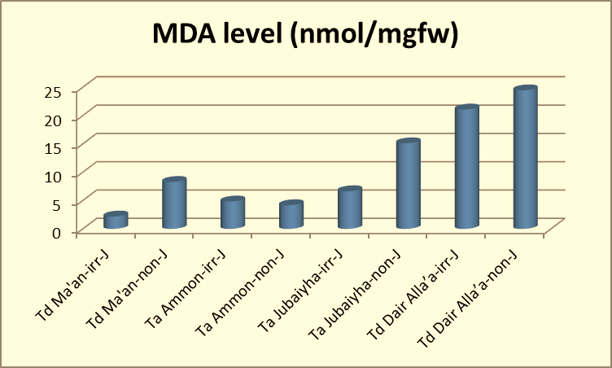
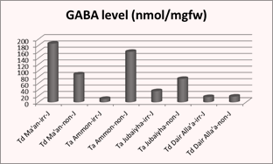
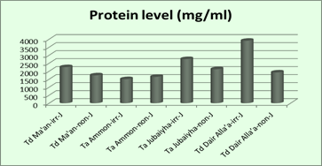
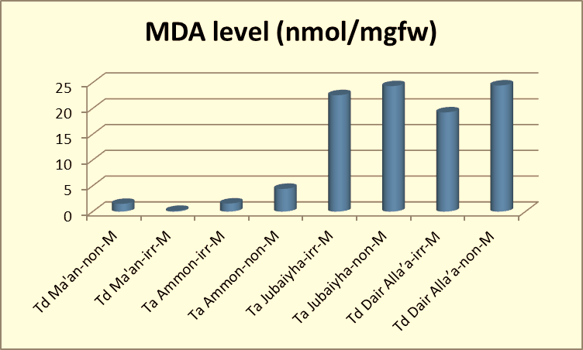
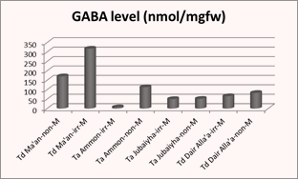
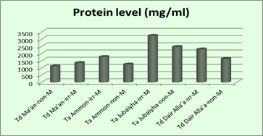
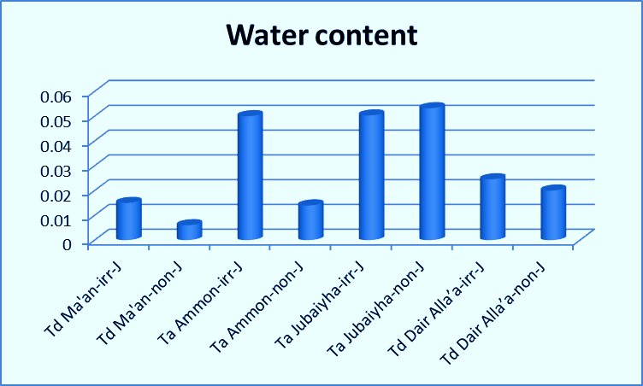
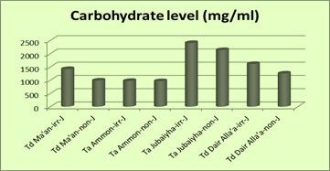
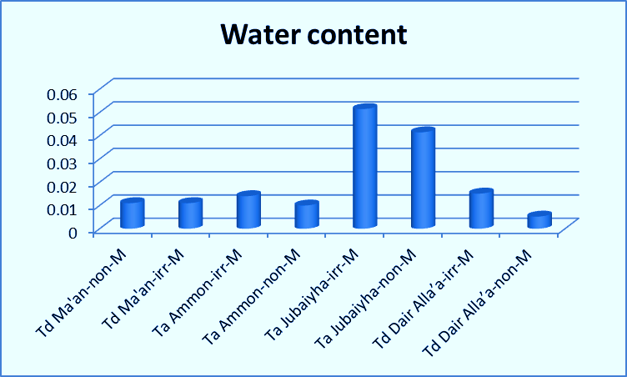
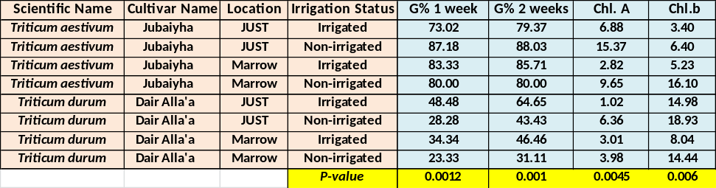
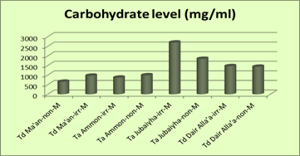
Jordan University of
Science and Technology
P1.030
Physiological impact of drought stress on cultivated wheat plants Triticum aestivum L. and Triticum durum L. growth and metabolism
N. AL-Quraan¹*, Z. Al-Ajlouni¹, N. Al-daken¹, H. Swid¹, A. AL-Ghzawi²
¹Jordan University of Science and Technology, ²Hashemite University
Introduction:
Drought is one of the most common environmental stresses that affect development, growth and metabolism in plants worldwide and continues to be an important challenge to plant breeders since four-tenths of the world's agricultural land lies in arid or semi-arid regions. Research is needed to critically define the effects of drought stress on growth and physiology of Wheat. Drought stress can result in retardation of growth, reduction in yield, and even death of the plants.
The objectives of this study were to examine the physiological response of two cultivars of Triticum aestivum L. (Ta) and two cultivars of Triticum durum L. (Td) under drought stress according to their planting location (JUST and Marrow) and irrigation status.
Materials and Methods:
After subjection of all cultivars to drought stress via different irrigation status; harvested seeds were planted on synthetic soil for 2 weeks and were irrigated with tap water daily. G%,, fresh weight and dry mass were measured. Shoot tissues were used to determine the MDA level as an indication of ROS, chlorophyll content, GABA metabolite accumulation level,
total carbohydrates and Protein levels.
Results:
. Data showed that germination % in Jubiyha and Ammon for (Ta) cultivar were higher than Ma’an and Dair Alla (Td) and the highest water content were recorded in Jubiyha (Ta) in comparison with the other cultivars included in this study.
The MDA level increase significantly in non-irrigated (drought) compared with irrigated cultivars.
GABA, carbohydrates and protein levels were significantly affected by drought stress in all cultivars.
Conclusion:
In conclusion our data indicates that Triticum aestivum L. (Ta) and Triticum durum L (Td) cultivars respond physiologically to drought stress in different manner in terms of growth and metabolism

Slide 19

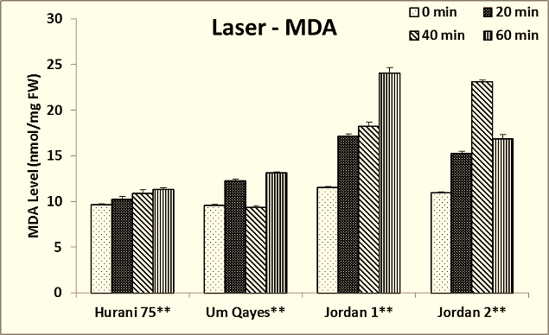
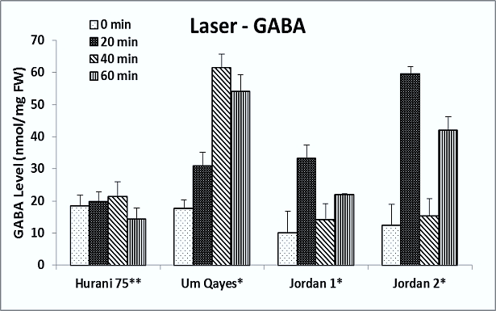
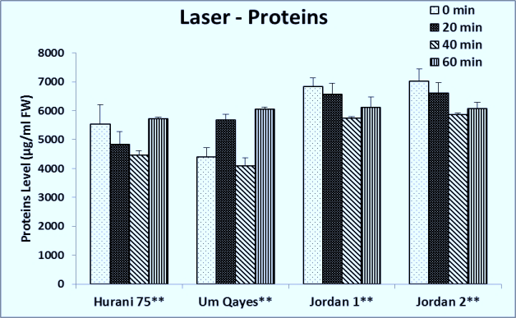
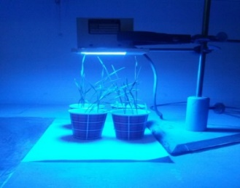
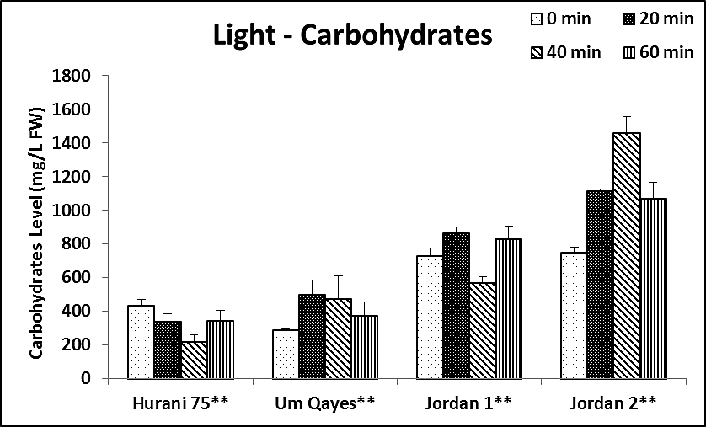
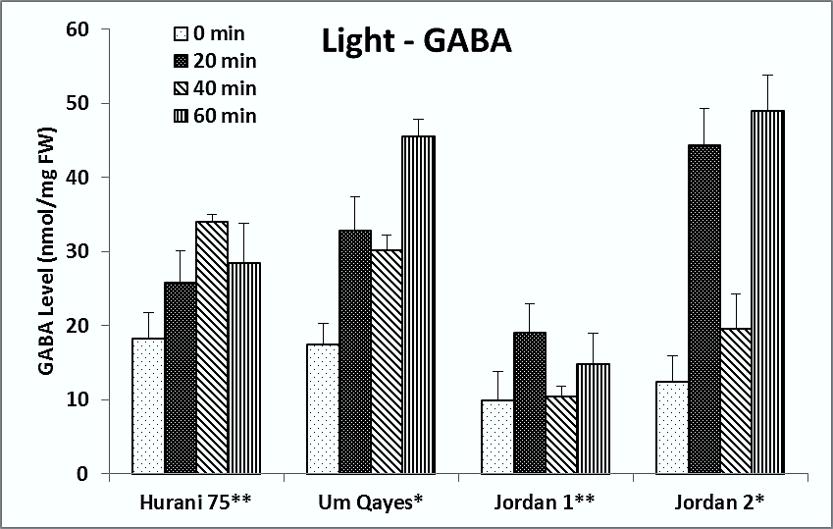
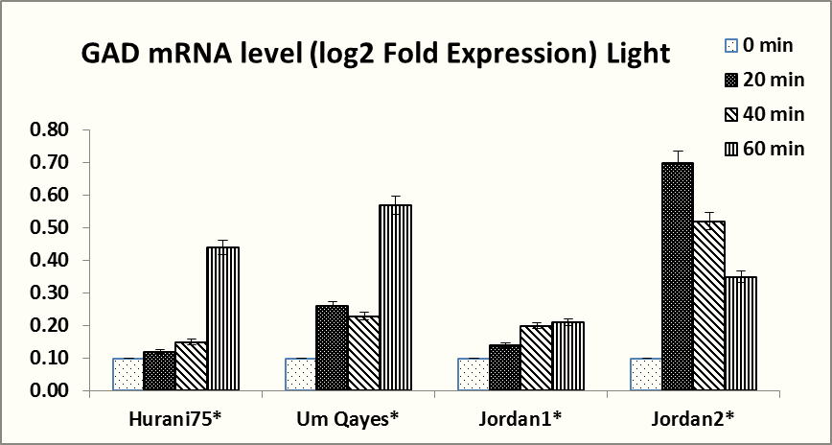
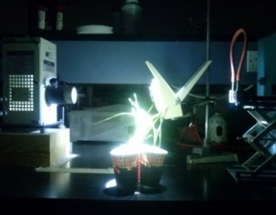
Jordan University of Science and Technology (JUST)
PN1800-143
The influence of Laser Beams and Light Intensities on Jordan Cultivated Lentil (Lens culinaris Medik) and Wheat (Triticum aestivum L.) Growth and Metabolism
Nisreen A. AL-Quraan¹*, Mohammed-Ali H. Al-Omari², Dua'a Z.Talafha¹
¹Department of Biotechnology and Genetic Engineering, ²Department of Physics, JUST
Introduction:
Light is considered as an environmental signal that controlled plants growth and development mainly by supplying sufficient duration, quality and wavelength of light intensities that is responsible for triggering on/off many physiological reactions.
The objective of this study was to examine the role of gamma aminobutyric acid (GABA) shunt pathway specific response in two wheat (Triticum aestivum L.) cultivars (Hurani 75 and Um Qayes) and two lentils (Lens culinaris Medik) cultivars (Jordan 1 and Jordan 2) to blue LED laser (intensity= 1.48 W/cm², 670 nm) and high intensity invisible ultraviolet light (intensity= 3.99 W/cm², 200-800 nm) treatments separately
Results:
Data showed a remarkable change of proteins contents, carbohydrates contents, chlorophyll level, dry and fresh weight, GABA accumulation, MDA level, and GAD m-RNA levels under blue LED laser and high intensity invisible ultraviolet light treatments; separately in the both wheat and lentils cultivars.
The concentrations of MDA increased in all cultivars under blue LED laser and high intensity invisible ultraviolet light treatments with increasing exposure durations.
GABA levels increased and correlated significantly in all cultivars as the exposure duration of blue LED laser and high light intensity increased; separately.
Data showed that a significant deceased of chlorophyll a and b content under all laser and high intensity invisible ultraviolet light treatments.
A significant difference was found in proteins content in all used cultivars in response to laser and high intensity invisible ultraviolet light treatments.
Carbohydrates content in all cultivars used in this study were significantly decreased under laser treatments.
The transcription level of GAD increased significantly under blue LED laser and high intensity invisible ultraviolet light in all used cultivars.
Conclusion:
Our results indicate that GABA shunt is a key metabolic pathway that allows wheat and lentil to adapt blue LED laser and high intensity invisible ultraviolet light treatments. Generally, based on our results; Hurani 75 and Jordan 2 have higher adaptation mechanism more than Um Qayes and Jordan 1, respectively in response to blue LED laser treatments. Hurani 75 and Jordan 1 could tolerate high intensity invisible ultraviolet light more than Um Qayes and Jordan 2, respectively.
Materials and Methods:
Examination of specific responses of two Jordanian winter wheat (Triticum aestivum L.) cultivars (Hurani75 and Um Qayes) and two Jordanian lentil (Lens culinaris Medik) cultivars (Jordan 1 and Jordan 2) to three different doses of blue LED laser irradiation and high intensity invisible ultraviolet light treatments, separately with respect to seed germination, seedling growth, oxidative damage in terms of reactive oxygen substances (ROS) accumulation, GABA accumulation level, total proteins and total carbohydrates level and glutamate decarboxylase gene (GAD) expression.
Blue LED Laser
High Light Intensity with UV

Slide 20


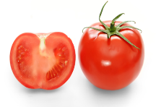
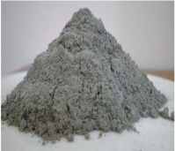
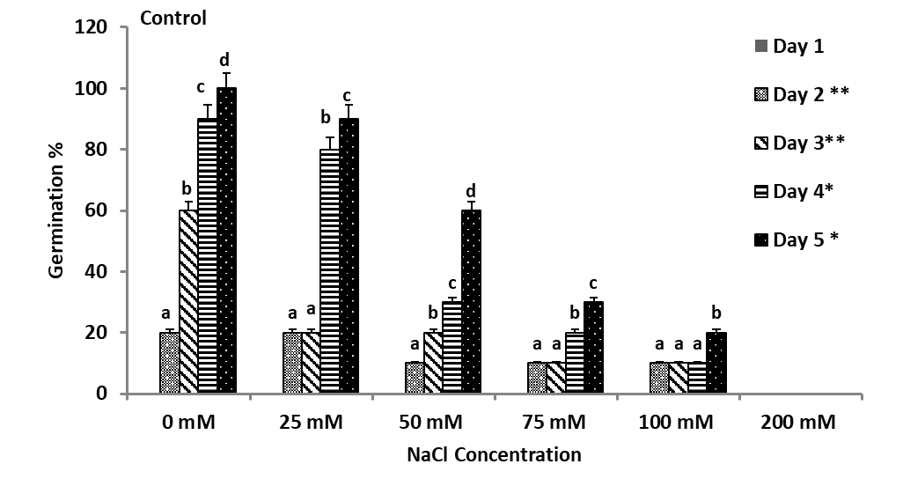
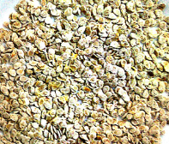
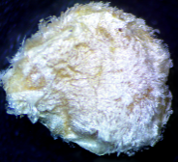
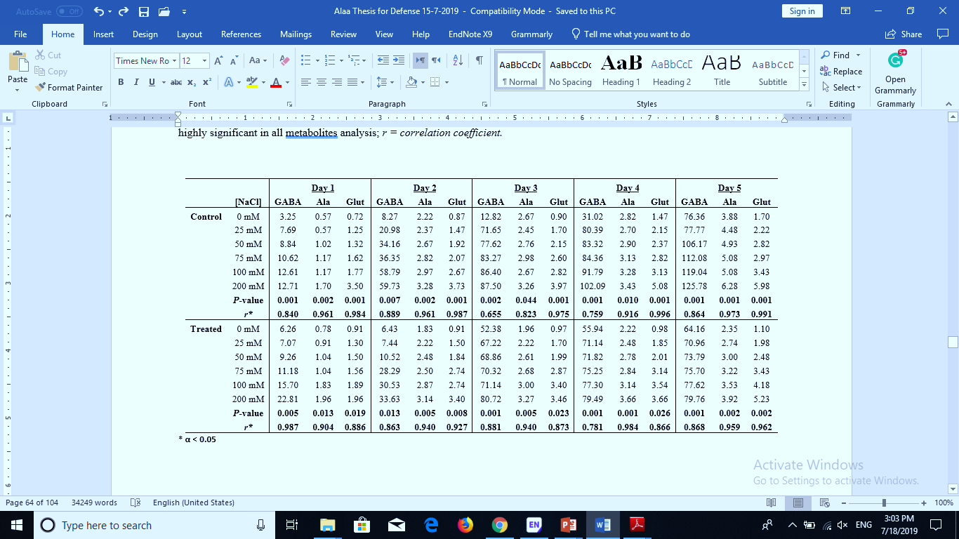
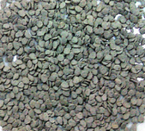
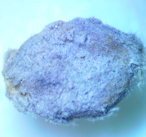
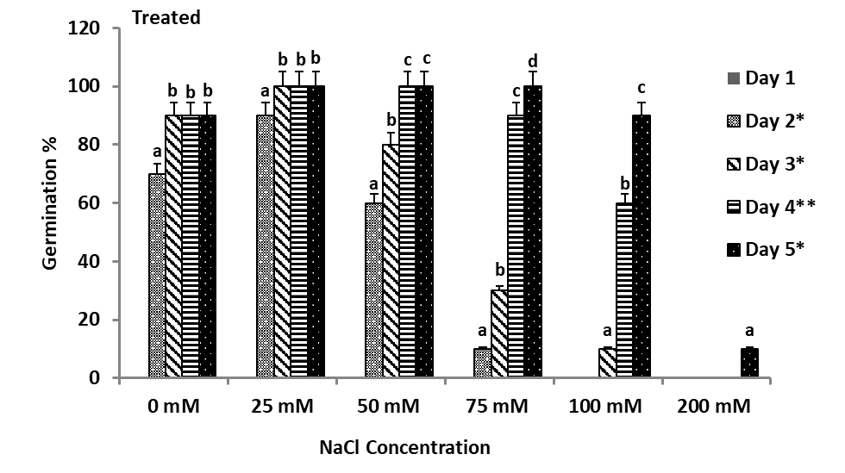
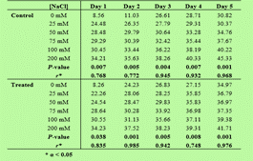
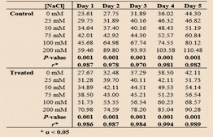
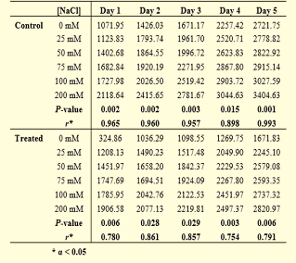
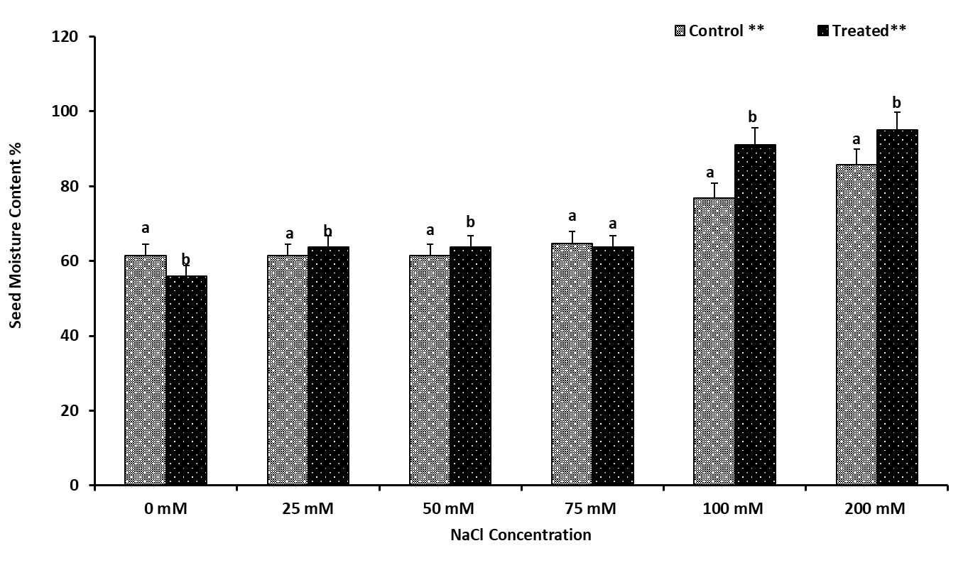
How to change the world via Science June 9-11, 2022 German-Jordanian University Madaba, Jordan
Effect of ash carbon nanofibers on GABA shunt pathway in germinating seeds of tomato (Lycopersicon esculentum Mill., c.v. Rohaba.) under salt stress
Nisreen A. AL-Quraan, Mohammed-Ali H. Al-Akhras, Ala’a A. Ayoub
Jordan University of Science and Technology
Introduction:
Fly ash (carbon nanofibers) has chemical and physical properties with a pH of 8.5 that are useful to neutralize soil acidity and improve plant production. Therefore, the utilization of fly ash in agriculture may provide a possible alternative for its safe disposal without severe harmful effects. In tomato, carbon nanotubes (CNTs) enhance tomato growth and development, activate genes expression, and stimulate seed germination. Furthermore, fly ash leads to improve growth and yield of many tomato cultivars. Traditionally, local farmers in Jordan preserve tomato (Lycopersicon esculentum Mill., c.v. Rohaba.) seeds for the next growing seasons by mixing it with fire carbon ash and keeping it under sunlight until complete drying.
Level of GABA shunt metabolites (GABA, alanine, and glutamate)
(nmol/mg FW)
@ this study demonstrated that carbon
nanofibers (CNFs) can be used to reduce salt stress effect during tomato seed germination. CNFs increased tomato seed moisture content by enhancing seeds water absorption, which in turn led to enhanced seed germination. In addition, CNFs increased GABA accumulation and their metabolites, alanine and glutamate, which may be involved in protein synthesis.
Level of total carbohydrates content (μg/mg FW)
Level of MDA (nmol/mg FW)
Objectives:
In this study, the effect of ash carbon nanofibers (CNFs) on GABA shunt pathway through the assessment of seed germination pattern, GABA shunt metabolite levels (GABA, Glutamate and Alanine), total proteins and total carbohydrates, and the level of oxidative damage in germinating seeds of tomato (Lycopersicon esculentum Mill., c.v. Rohaba.) under salt stress were determined. The functional role of the GABA shunt pathway, metabolic homeostasis, redox stability, and the strength of the C:N sink during tomato seed germination were also investigated.
Level of total protein content (μg/mL FW)
@ CNFs caused an increase in protein and carbohydrate levels and activation of GABA shunt, which contributed to protein and carbohydrate production and C:N balance. Activation of the GABA shunt could be also involved in reduction of MDA accumulation and oxidative damage under salt stress. Consequently, ash carbon nanofibers showed great effects to tolerate salt stress for seed germination in tomato. Further studies are needed to explore the effects of CNFs on different developmental stages of plant species under different abiotic stresses.
Al-Quraan, N.A. and Al-Akhras, M.A.H., 2021. Effect of ash carbon nanofibers on GABA shunt pathway in germinating seeds of tomato (Lycopersicon esculentum Mill., cv Rohaba.) under salt stress. Turkish Journal of Botany, 45(2), pp.124-139.

